Slide 1
AN ML APPROACH TO UNDERSTAND A PERSON BETTER
-BY NIHARIKA PENTAPATI & AISHWARYA K

Slide 2
BLOCK DIAGRAM
RAW DATA
PRE-PROCESSING
PROCESSING
EXTRACT USEFUL INFORMATION
ASSIGNING TO CATEGORIES
INDEX

Slide 3
IMPLEMENTATION
PRE-PROCESSING: Removing noise like punctuations, emojis, internet slang etc. and data conversion to lowercase for ensuring uniformity.
PROCESSING: Now this pre- processed data must be processed to extract useful information using Information Retrieval and machine learning techniques like clustering, word embedding : converting words into vectors , Similarity metrics etc. to extract useful data.
CLASSIFICATION OF RAW DATA: Raw data can be broadly classified into text and images.
The semantics of the text can be understood using various techniques like word level and sentence level embedding, similarity checking, sentiment analysis etc. **
Reading and captioning of an image: Andrej Karpathy paper.
CATEGORIZING: Different sentences can be classified into various categories.
INDEXING: Then depending on the requirement these categories can be assigned certain values or indexes.

Slide 4
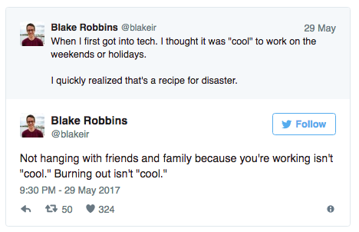
examples
Conclusion: workaholic, pressure taker

Slide 5
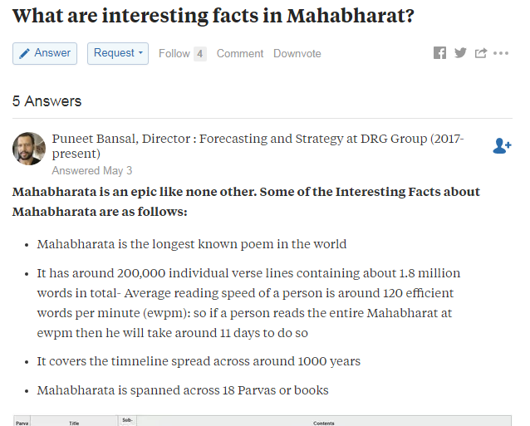
Conclusion: Religious, interested in mythology

Slide 6
Feasibility
COST EFFECTIVE
IMPLEMENTATION: Practically possible with current research. Accuracy depends on the methodology.
TIME FACTOR: Quick, depends on how much data is considered.
ROBUST
RELIABLE: The posts and blogs extracted are usually posted by the user himself and thus is very reliable.

Slide 7
APPLICATIONs
Employment index: An employee’s behavior, habits, emotions can be captured and understood from useful data
Counselor: a counselor or a counseling firm can use this useful information to know more about the person, his mental stability, feelings, likes and dislikes etc.
Student admission: during admissions in colleges or schools, knowing the student’s behavior and background becomes really important.
Matrimonial websites
Advertising agencies: provides personalized advertisements

